Slide 1
Non –parametric estimation

Slide 2
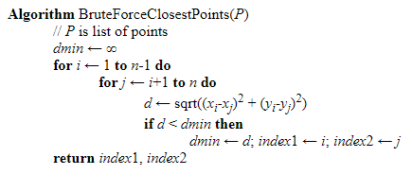
Sample Problems
Answers!
Devise a brute force algorithm for a given coordination matched vector?
Brute force algorithm computes the distance between every distinct set of points and returns the indexes of the point for which the distance is the smallest. Brute force solves this problem with the time complexity of [O(n2)] where n is the number of points.
Use the algorithm to find the nearest points and than devise a solution
based on their cartesian distance

Slide 3
Types of Probability
What is the difference between statistical and structural probability?
In statistical l probability the data is reduced to vectors of numbers and statistical techniques are used for the tasks to be performed.
In structural probability the data is converted to a discrete structure(such as a grammar or a graph) and the techniques are related parsing and graph matching.
Question 3: Define an extremely complex pattern recognition problem?
It could range from Genetics to Satellite image processing

Slide 4
Two Schools of Thought
Statistical Pattern Recognition
The data is reduced to vectors of numbers
and statistical techniques are used for
the tasks to be performed.
2. Structural Pattern Recognition
The data is converted to a discrete structure
(such as a grammar or a graph) and the
techniques are related to computer science
subjects (such as parsing and graph matching).

Slide 5
Explore the AIMs?
1. How should objects to be classified be
represented?
2. What algorithms can be used for recognition
(or matching)?
3. How should learning (training) be done?

Slide 6
Understand Classification in Statistical PR
A class is a set of objects having some important
properties in common
A feature extractor is a program that inputs the
data (image) and extracts features that can be
used in classification.
A classifier is a program that inputs the feature
vector and assigns it to one of a set of designated
classes or to the “reject” class.
With what kinds of classes would you choose?

Slide 7
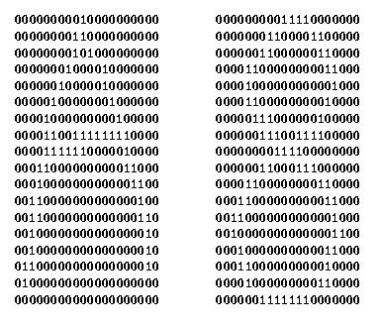
Feature Vector Representation
X=[x1, x2, … , xn], each xj a real number
xj may be an object measurement
xj may be count of object parts
Example: object rep. [#holes, #strokes, moments, …]

Slide 8
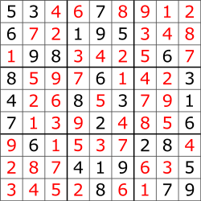
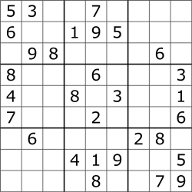
A Sudoko Puzzle

Slide 9
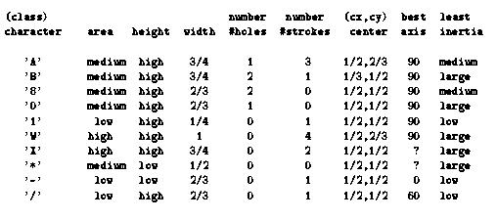
Possible features for char recognition

Slide 10
Some Terminology
Classes: set of m known categories of objects
(a) might have a known description for each
(b) might have a set of samples for each
Reject Class:
a generic class for objects not in any of
the designated known classes
Classifier:
Assigns object to a class based on features

Slide 11
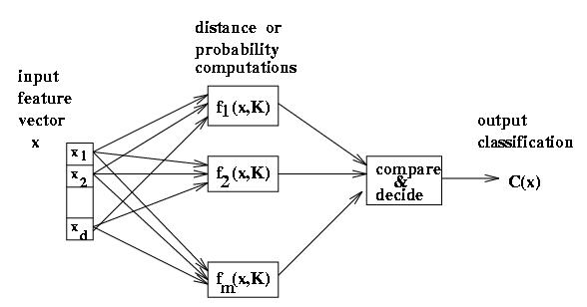
Discriminant functions
Functions f(x, K) perform some computation on feature vector x
Knowledge K from training or programming is used
Final stage determines class

Slide 12
Classifiers often used in Computer Vision
Decision Tree Classifiers
Artificial Neural Net Classifiers
Bayesian Classifiers and Bayesian Networks
(Graphical Models)
Support Vector Machines

Slide 13
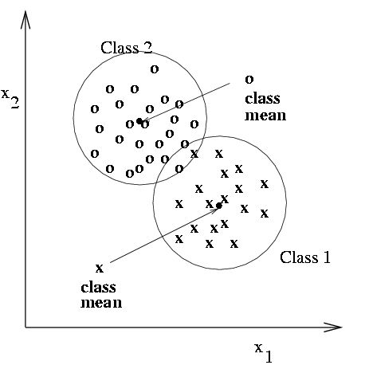
Classification using nearest class mean
Compute the Euclidean distance between feature vector X and the mean of each class.
Choose closest class, if close enough (reject otherwise)

Slide 14
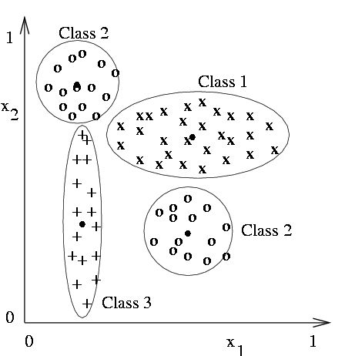
Nearest mean might yield poor results with complex structure
Class 2 has two modes; where is
its mean?
But if modes are detected, two subclass mean vectors can be used

Slide 15
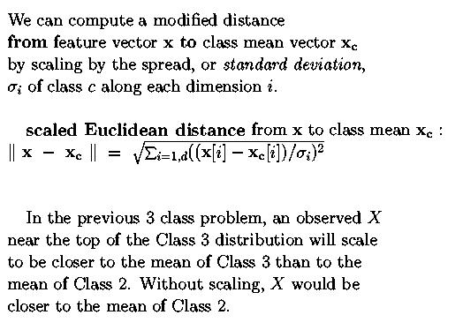
Scaling coordinates by std dev

Slide 16
Nearest Neighbor Classification
Keep all the training samples in some efficient
look-up structure.
Find the nearest neighbor of the feature vector
to be classified and assign the class of the neighbor.
Can be extended to K nearest neighbors.

Slide 17
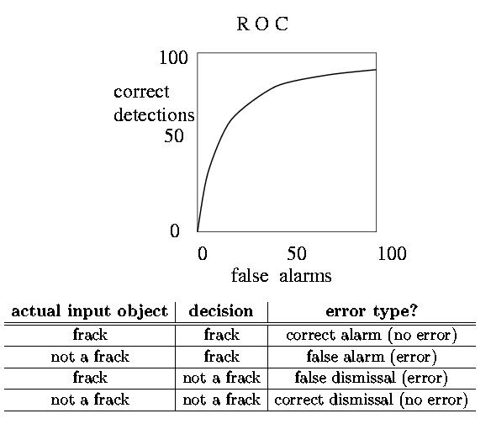
Receiver Operating Curve ROC
Plots correct detection rate versus false alarm rate
Generally, false alarms go up with attempts to detect higher percentages of known objects

Slide 18
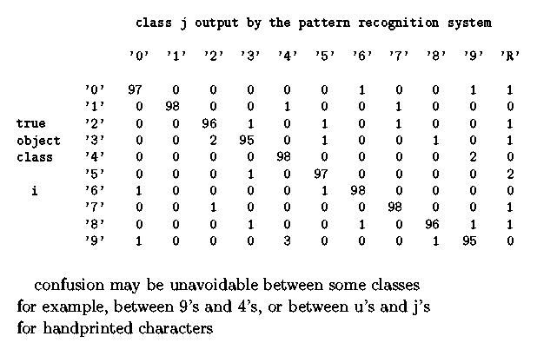
Confusion matrix shows empirical performance

Slide 19
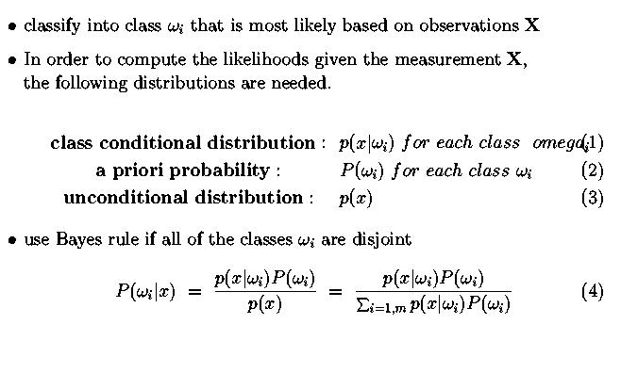
Bayesian decision-making

Slide 20
Decision Trees
#holes
0
2
1
moment of
inertia
#strokes
#strokes
< t
≥ t
0
1
best axis
direction
#strokes
0
1
0
90
2
4
60
- / 1 x w 0 A 8 B

Slide 21
Decision Tree Characteristics
Training
How do you construct one from training data?
Entropy-based Methods
2. Strengths
Easy to Understand
3. Weaknesses
Overtraining

Slide 22
Entropy-Based Automatic Decision Tree Construction
Node 1
What feature
should be used?
Training Set S
x1=(f11,f12,…f1m)
x2=(f21,f22, f2m)
.
.
xn=(fn1,f22, f2m)
What values?

Slide 23
Entropy
Given a set of training vectors S, if there are c classes,
Entropy(S) = ∑ -pi log (pi)
Where pi is the proportion of category i examples in S.
c
i=1
2
If all examples belong to the same category, the entropy
is 0.
If the examples are equally mixed (1/c examples of each
class), the entropy is a maximum at 1.0.
e.g. for c=2, -.5 log .5 - .5 log .5 = -.5(-1) -.5(-1) = 1
2
2

Slide 24
Information Gain
The information gain of an attribute A is the expected
reduction in entropy caused by partitioning on this attribute.
|Sv|
Gain(S,A) = Entropy(S) - ∑ Entropy(Sv)
v ∈ Values(A)
|S|
where Sv is the subset of S for which attribute A has
value v.
Choose the attribute A that gives the maximum
information gain.

Slide 25
Information Gain (cont)
Set S
Attribute A
v1
v2
vk
Set S ′
S′={s∈S | value(A)=v1}
repeat
recursively
Information gain has the disadvantage that it prefers
attributes with large number of values that split the
data into small, pure subsets.

Slide 26
Gain Ratio
Gain ratio is an alternative metric from Quinlan’s 1986
paper and used in the popular C4.5 package (free!).
Gain(S,a)
GainRatio(S,A) = ------------------
SplitInfo(S,A)
ni
|Si|
|Si|
SplitInfo(S,A) = ∑ - ----- log ------
i=1
|S|
2
|S|
where Si is the subset of S in which attribute A has its ith value.
SplitInfo measures the amount of information provided
by an attribute that is not specific to the category.

Slide 27
Information Content
Note:
A related method of decision tree construction using
a measure called Information Content is given in the
text, with full numeric example of its use.

Slide 28
Artificial Neural Nets
Artificial Neural Nets (ANNs) are networks of
artificial neuron nodes, each of which computes
a simple function.
An ANN has an input layer, an output layer, and
“hidden” layers of nodes.
.
.
.
.
.
.
Outputs
Inputs

Slide 29
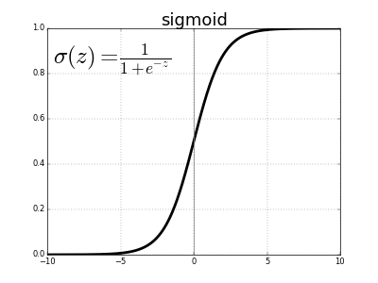
Node Functions
a1
a2
aj
an
w(1,i)
neuron i
output
w(j,i)
output = g (∑ aj * w(j,i) )
Function g is commonly a step function, sign function,
or sigmoid function

Slide 30
Neural Net Learning
That’s beyond the scope of this text; only
simple feed-forward learning is covered.
The most common method is called back propagation.
A free package called NevProp can be used for experiments
https://www.cse.unr.edu/brain/nevprop
What do you use?

Slide 31
Support Vector Machines (SVM)
Support vector machines are learning algorithms
that try to find a hyperplane that separates
the differently classified data the most.
They are based on two key ideas:
Maximum margin hyperplanes
A kernel ‘trick’.

Slide 32
Maximal Margin
1
Margin
0
1
1
0
0
1
Hyperplane
0
Find the hyperplane with maximal margin for all
the points. This originates an optimization problem
Which has a unique solution (convex problem).

Slide 33
Non-separable data
0
1
0
0
0
1
1
0
1
0
1
0
1
0
1
1
0
0
0
1
0
What can be done if data cannot be separated with a
hyperplane?

Slide 34
The kernel trick
The SVM algorithm implicitly maps the original
data to a feature space of possibly infinite dimension
in which data (which is not separable in the
original space) becomes separable in the feature space.
Original space R^{k}
Feature space R^{n}
1
0
1
1
0
0
1
0
0
1
0
Kernel
trick
0
1
0
0
0
1
1

Slide 35
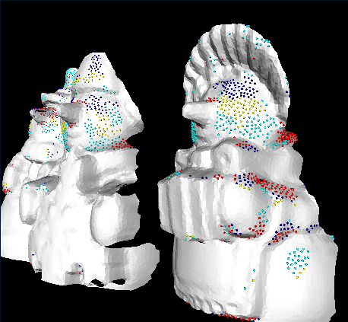
Snowman with Patches

